Slide 1
A Stack
Definition:
An ordered collection of data items
Can be accessed at only one end (the top)
Operations:
construct a stack (usually empty)
check if it is empty
Push: add an element to the top
Top: retrieve the top element
Pop: remove the top element

Slide 2
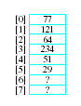
Selecting Storage Structure
Model with an array
Let position 0 be top of stack
Problem … consider pushing and popping
Requires much shifting

Slide 3
Selecting Storage Structure
A better approach is to let position 0 be the bottom of the stack
Thus our design will include
An array to hold the stack elements
An integer to indicate the top of the stack

Slide 4
Implementing Operations
Constructor
Compiler will handle allocation of memory
Empty
Check if value of Top == -1
Push (if Array not full)
Increment Top by 1
Store value in Array [Top]
Top
If stack not empty, return Array[Top]
Pop
If array not empty, decrement Top
Output routine added for testing

Slide 5
The Stack Struct
The completed Stack.h file,
All functions defined
Note use of typedef mechanism
Implementation file, Stack.cpp,
,
Creates stack of 4 elements
Demonstrates error checking for stack full, empty

Slide 6
Dynamic Array to Store Stack Elements
Same issues regarding static arrays for stacks as for lists
Can run out of space if stack set too small
Can waste space if stack set too large
Note additional data members required

Slide 7
Applications of the ADT Stack: Checking for Balanced Braces
C/C++ and Java uses curly braces { and } to delimit groups of statements. If you treat a java program as a sequence of characters
A stack can be used to verify whether a program contains balanced braces
An example of balanced braces
abc{defg{ijk}{l{mn}}op}qr
An example of unbalanced braces
abc{def}}{ghij{kl}m

Slide 8
Checking for Balanced Braces
Requirements for balanced braces
Each time you encounter a “}”, it matches an already encountered “{”
When you reach the end of the string, you have matched each “{”

Slide 9
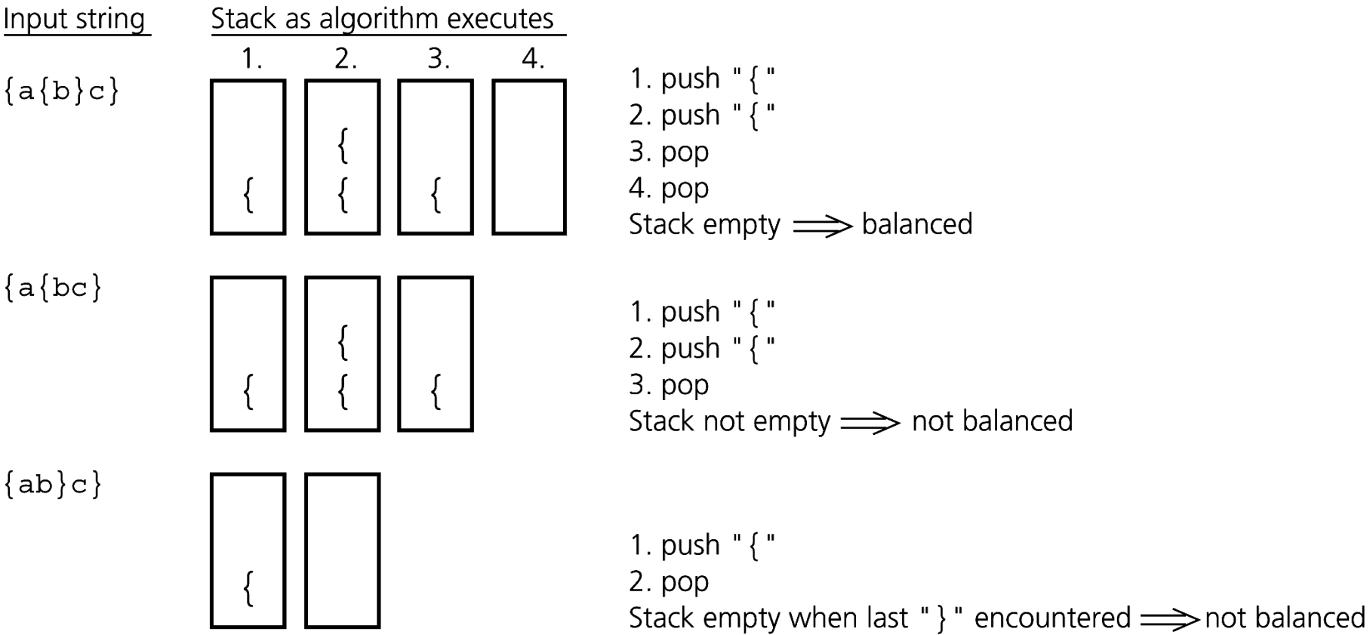
Checking for Balanced Braces
Traces of the algorithm that checks for balanced braces

